Slide 1
Grow Your Own: A Systemic Approach to Securing an Effective Educator Talent Pool
Developing a Grow Your Own Strategic Action Plan

Slide 2
Module 3: Developing a Grow Your Own Strategic Action Plan Objectives
Review the importance of goals.
Assess your current Grow Your Own (GYO) goal(s).
Develop a common understanding of a strategic action plan and its key components.
Determine steps to monitor your progress toward your goals.
Notes:
This session will build on the previous session in which we reviewed the Talent Development Framework and discussed sources of data to inform the development of GYO programs that are based on local needs and context. Next, we will learn about how to create a strategic action plan toward these goals, identifying the stakeholders, activities, and indicators of success on the pathway toward these long-term goals.

Slide 3
Review of Educator Talent Goals

Slide 4
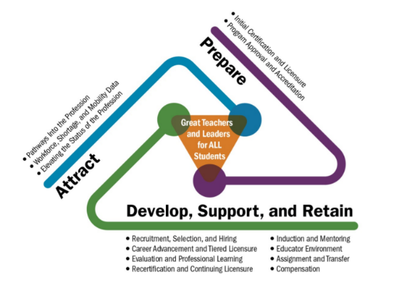
Talent Development Framework
Source: The Center on Great Teachers and Leaders. (2014). Talent development framework for 21st century educators: Moving toward state policy alignment and coherence. Washington, DC: American Institutes for Research.
Notes:
In Module 2, you learned about the Talent Development Framework, shown here, and:
Module 2 objectives:
▪ Understand how GYO fits into a comprehensive talent development framework.
▪ Identify sources of data to inform the development of GYO programs that are based on local needs and context.
▪ Discuss how GYO programs address equity gaps and improve workforce diversity.
Reflect upon:
▪ What are your specific needs—and how do you know? (What are the data telling you?)
▪ How did those translate into specific goals around GYO?

Slide 5
Assessing Your Educator Talent Goals

Slide 6
Goal and Condition
Where are you headed?
Goal
What is true when you get there?
Condition
Notes:
The first thing you should do before leaping into a strategic action plan is assess your goals.
Remember, you started in the last module to reflect upon the following questions:
▪ What are your specific needs—and how do you know? (What are the data telling you?)
▪ How did those translate into specific goals around GYO?
But now you need to dig deeper and do two things:
 First, ask yourself, What are the conditions you want in your state or districts? Do these goals align with those conditions?
For example, a condition might be that there is no teacher shortage in Special Education positions. Your related goal might be, “By 2025, our state has at least 320 unique applicants for the 160 vacancies we have on average each year.”
Another example is that you seek the condition of high first-year teacher retention. A related goal might be, “By the 2021–2022 school year, our first-year teacher attrition rate is at or below the 11% national average – and below our current attrition rate of 20%.”
One more example is that you seek increased interest in and respect for the teaching profession in your high school students—that’s the condition you seek. It can be measured by setting one goal around “10% of Harrison County ACT takers indicate an interest in pursuing an education degree, compared to the national average of 4–5%.”
Emphasize why it’s important to set goals.
What is the minimum impact you’d want to see when you go through all this effort of implementing a new GYO program? What would make it worth it? Do your goals align with this?
If yes, then we can move forward. If not, you need to revisit your goals.

Slide 7
SMART Goal
S
M
A
R
T
Specific
Measurable
Actionable
Relevant
Time-bound
Notes:
Second, you need to assess where your goal is SMART. “SMART” is just an acronym to help you assess the rigor of your goal.
Is your goal SMART?
Specific
Measurable
Actionable
Relevant
Time-bound
Is it talking about a specific problem or opportunity? Can you measure it? Can you use the goal to change a behavior and therefore take an action? Does it matter? And have you set a time period on it?
A strong example within GYO is, “Increase enrollment in Education and Training courses in district high schools by 25% from SY2018–19 to SY2019–2020.” It has all the characteristics required and can be used to drive actions of those involved.
If all these things are true of your goal, then you have likely set a goal that is worthy of being pursued by you and your stakeholders.

Slide 8
Strategic Action Plan

Slide 9
A rose by any other name…
Plan
Goal
Strategic Action Plan
High Level
Strategic Plan
Logic Model
Theory of Change
ToC
Theory of Action
(ToA)
Notes:
Yes, a strategic action plan can have many names… a logic model, a theory of action, a theory of change, a high-level strategic plan.
But when it all comes down to it, it’s just your plan. Your plan to get to, or achieve, your goals.
DON’T be overwhelmed by the names or theory or anything else that is thrown at you.
DO be sure you map out where you’re going, so you get there!
What is the purpose of a Strategic Action Plan?
▪ It organizes your work and begins to assign ownership.
▪ It can communicate your work internally and externally.
▪ It allows you to see missteps and reconfigure as necessary when off track toward achieving goals.

Slide 10
Your Strategic Action Plan: The Buckets
Pathway: GYO High School Pathway for Dual Credit
Inputs
Activities
Outputs
Outcomes
Grant funding from SEA
Resources purchased and developed
LEA and IHE partnership for dual credit
$1,000 grant and professional development for teachers
ETC courses for HS students with college credit
Waived admissions fee and $1,000 scholarship at IHE partner
Teachers of ETC hold at least a master’s degree
HS students earn college credit in HS
30 additional enrollees per year in X university program from ETC graduates
4 identified rural districts don’t report STEM vacancies within 10 years due to GYO pathway
GOAL: Increase number of STEM teachers by 200% by 2025.
Notes:
A few suggestions are embedded below.
What are the big pieces of a Strategic Action Plan?
Start with YOUR GYO GOAL/Outcomes. Then, what would you—and your stakeholders and partners—like to do to get to those outcomes? Those are your activities and inputs. Then your desired results are the outcomes. The outputs are what are directly created by the actions.
Inputs: Who is taking action?
Activities: What actions are they taking?
Outputs: What will be created by these actions?
Outcomes—possibly the same as goals: what you’d ultimately like to achieve through your GYO program. (Outcomes include the components that indicate you are making progress toward your goal and your short-, middle-, and long-term outcomes.)
The terminology is NOT the most important thing; the plan is!
Ideally, the outputs created by the actions taken will lead to the outcomes—or goals—that you intended. However, if you aren’t seeing this, you need to go back and adjust your plan.
▪ Where does the logic break down?
▪ Who do you need to involve in conversations to figure this out?
Multiple visuals and examples to show there is not one right way!
Also emphasize the customization of GYO in general.
Inputs could also include grant funding, resources purchased or developed, etc.
How should the actions be modified for each context? For example, how would it look different for the urban, suburban, or rural areas?
For example: the sign-in sheet that tells you who and how many attended a training. (The sign-in sheet is a good output, and the outcome is the increased understanding of the content.)
I also want to emphasize that it’s important to use your data—which you learned about in Module 2 [use name if possible]—and partners and other stakeholders to help you make this plan. They will be partners in executing the plan, so they should be at the table now, helping you ensure the right plan is in place to reach your goals.

Slide 11
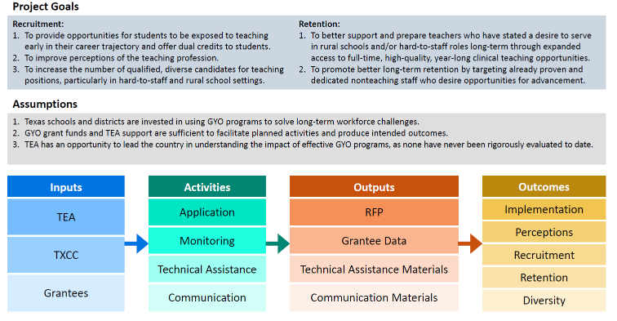
Example: Texas GYO Logic Model
Source: Texas Comprehensive Center. (2018). Grow Your Own teachers initiatives logic model. (Unpublished working document). Austin, TX: American Institutes for Research.
Notes:
Remember, the specific design is less important than having the pieces themselves. The plan should have inputs and activities that enable one to gather specific data that lead to clear decisions about continuing down paths toward the outcomes.
You should be able to identify your milestone, have clear and consistent talking points among stakeholders, use these to organize your partners toward your common goal and outcomes, as well as activities, and more.

Slide 12
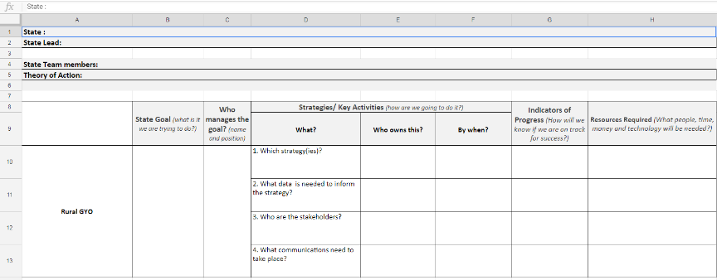
Example: CCSSO GYO State Planning Template
Source: Council of the Chief State School Officers. (2018). Grow Your Own state planning template. (Unpublished working document). Washington, DC: Author.
Notes:
This example is from CCSSO, slightly modified for a rural context. It starts with the goal—as one should—and then goes into the planning of who, what, when, indicators of progress, and resources required. As with any plan, the format is less important than the plan itself.
The plan should enable you to draw a map toward your goal and have benchmarks—or indicators—along the way to note how you are or aren’t progressing toward those goals, so you can edit the plan as needed.

Slide 13
Monitoring Progress

Slide 14
Evaluating Along the Way
Notes:
Suggestions below
How will you monitor your progress?
What successes are you starting to see, build traction on—the stories you tell? Those are indicators of success or non-success (or the need to make some midcourse corrections). Your goals are rooted in data, which can be big or small, depending on your size.
What would tell you that you are moving in the right direction? More people signing up for ETC classes? Fewer people dropping out? Other changes in behavior—that’s really what you are looking for!
These pieces can help us evaluate if we’re on track toward achieving the outcomes.
It can also help us improve our plan in real time—and not wait until 5 years in to adjust. For example, if we’ve added a new community-focused program to recruit paraprofessionals to the classroom, we want to ensure things are on track.
We can find out that 95% of our enrollees have successfully completed their first semester of coursework at the local IHE. CLICK — that indicates we are moving in the right direction and we should keep going. Or we could find that our information session was attended by only five people, and we need to recruit 12 to get the program going. That tells us that we need to — CLICK — adjust our recruitment strategy slightly. Or maybe we have limited data or success, like there haven’t been any STEM recruits yet and that’s our real need in the district, and we need to proceed with caution — CLICK — on a certain activity before going all in.
This evaluation is helpful as it keeps your Strategic Action Plan a working, or LIVING, document that tells the story of (and guides) your work—and adjusts when necessary, based on monitoring that you and your partners are actively doing.

Slide 15
Next Steps

Slide 16
So… now what?
Notes:
So NOW WHAT?
Now, it’s important to bring your goals together with a plan to get there. Who needs to be involved in that planning? What will need to happen to get there?
This process should be collaborative, with the right stakeholders at the table. If you need some assistance kicking it off, reach out. There are experts here to help.

Slide 17
References
Center on Great Teachers and Leaders. (2014). Talent development framework for 21st century educators: Moving toward state policy alignment and coherence. Washington, DC: American Institutes for Research. Retrieved from https://gtlcenter.org/sites/default/files/14-2591_GTL_Talent_Dev_Framework-ed_110714.pdf
Council of the Chief State School Officers. (2018). Grow Your Own state planning template. (Unpublished working document). Washington, DC: Author.
Texas Comprehensive Center. (2018). Grow Your Own teachers initiatives logic model. (Unpublished working document). Austin, TX: American Institutes for Research.

Slide 18
Elizabeth Nelson
512-391-6547
enelson@air.org
1000 Thomas Jefferson Street NW
Washington, DC 20007
800-634-0503
www.ccrscenter.org | ccrscenter@air.org

